Slide 1

Data Science

Slide 2

معالجة اللغات الطبيعية Natural Language Processing(NLP) تطبيق عملي-تهيئة البيانات النصيه -٤ هندسة المدخلات -الخصائص Feature Scaling Feature Engineering
Ahmad Shhadeh

Slide 3
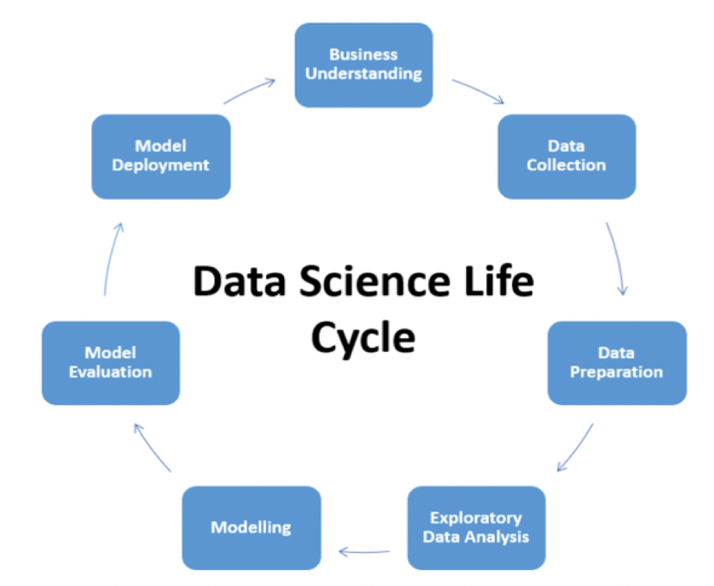
Data Science Project life cycle
Business Understanding
Data Collection
Data Preparation
Exploratory data analytics(EDA)
Data Modelling
Model Evaluation
Model Deployment

Slide 4
Pre-processing text data
Cleaning up the text data is necessary to highlight attributes that we are going to want our model to pick up on. Cleaning (or pre-processing) the data typically consists of number of steps:
Removing punctuation
Converting text to lowercase
Tokenization
Removing stop-words
Lemmatization /Stemming
Vectorization
Feature Engineering

Slide 5
Pre-processing text data
Cleaning up the text data is necessary to highlight attributes that we are going to want our model to pick up on. Cleaning (or pre-processing) the data typically consists of number of steps:
Removing punctuation
Converting text to lowercase
Tokenization
Removing stop-words
Lemmatization /Stemming
Vectorization
Feature Engineering

Slide 6
Feature Engineering
Feature engineering : is the process of transforming raw data into features that better represent the underlying problem to the predictive models, resulting in improved model accuracy on unseen data.
Feature engineering asks: what is the best representation of the sample data to learn a solution to your problem? How to turn your inputs into things the algorithm can understand
some machine learning projects succeed and some fail. What makes the difference? Easily the most important factor is the features used.
One of the most factor of success or fail some machine learning projects succeed is the features used.
Feature engineering efforts mainly have two goals:
Preparing the proper input dataset, compatible with the machine learning algorithm requirements.
Improving the performance of machine learning models,(the features that will not add any value will not be considered in order to keep space and time)
Better features mean: flexibility, simpler models & better results

Slide 7
Feature Engineering- Customer Segmentation example
InvoiceNo | StockCode | Description | Quantity | InvoiceDate | UnitPrice | CustomerID | Country
536365 | 85123A | WHITE HANGING HEART T-LIGHT HOLDER | 6 | 01/12/2010 08:26 | 2.55 | 17850 | UK
536365 | 71053 | WHITE METAL LANTERN | 6 | 01/12/2010 08:26 | 3.39 | 17850 | UK
536365 | 84406B | CREAM CUPID HEARTS COAT HANGER | 8 | 01/12/2010 08:26 | 2.75 | 17850 | UK
536365 | 84029G | KNITTED UNION FLAG HOT WATER BOTTLE | 6 | 01/12/2010 08:26 | 3.39 | 17850 | UK
536365 | 84029E | RED WOOLLY HOTTIE WHITE HEART. | 6 | 01/12/2010 08:26 | 3.39 | 17850 | UK

Slide 8

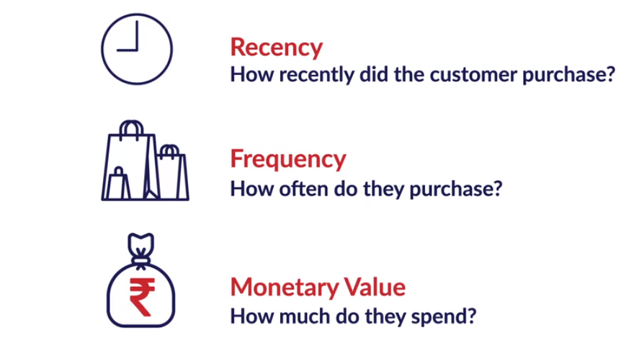
Feature Engineering : Customer Segmentation example

Slide 9
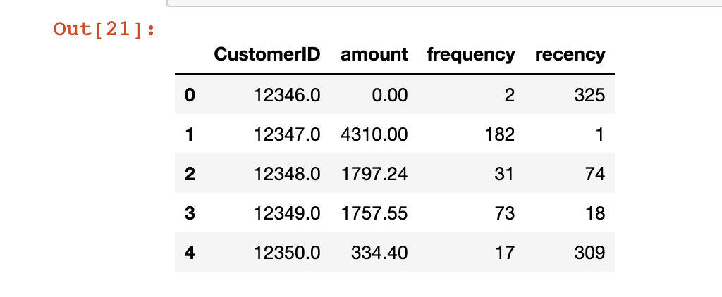
Feature Engineering
# new column: amount
retail_df['amount'] = retail_df['Quantity']*retail_df['UnitPrice’]
# monetary
df = retail_df.groupby('CustomerID')['amount'].sum()
# frequency
frequency = retail_df.groupby('CustomerID')['InvoiceNo'].count()
frequency.columns = ['CustomerID', 'frequency’]
# recency
# compute the max date
max_date = max(retail_df['InvoiceDate’])
# compute the diff
retail_df['diff'] = max_date - retail_df['InvoiceDate’]
last_purchase = retail_df.groupby('CustomerID')['diff'].min()

Slide 10
Creating new features
The length of the text field. Maybe spam tends to be a little bit longer than real text messages.
The intuition behind entering the length of message as a feature is that the cost of sending a text message is the same as long as it is contained below 160 characters, so marketers would prefer to use most of the space available to them as long as it doesn’t exceed the limit
The percent of the characters in the text message are punctuation.
Hypotheses : real text messages use less punctuation than spam
The percent of characters are capitalized are indicative of whether it's spam or not.
Hypotheses : real text messages use less capital letters than spam
The number/percentage of ‘A’s in the text message

Slide 11
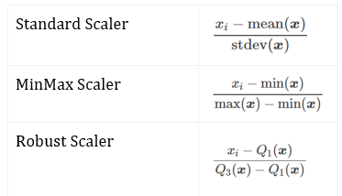
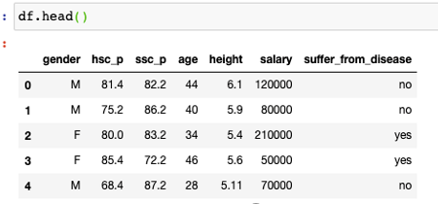
Feature Scaling or Standardization
Feature scaling is about transforming the values of different numerical features to fall within the similar range like each other.
Any Algorithm which is Not Distance based is Not affected by Feature Scaling,(Naive Bayes, Linear Discriminant Analysis, and Tree-Based models are not affected by feature scaling
It basically helps to normalize the data within a particular range.
Sometimes, it also helps in speeding up the calculations in an algorithm
StandardScaler
MinMaxScaler :
RobustScaler

Slide 12
Course Contents
https://dair.ai/notebooks/nlp/2020/03/19/nlp_basics_tokenization_segmentation.html

